Slide 1

Communication
Introduction
Notes:
http://www.rttworks.com/images/PowComArt.gif

Slide 2
Lesson Objective: Understand Communication from a technical and scientific perspective

Slide 3
If all my possessions were taken from me
with one exception, I would hope to keep
my power of communication
--- for by it I would regain all the rest.”
--Daniel Webster, American Journalist

Slide 4
"I know that you believe you understand what you think I said, but I'm not sure you realize that what you heard is not what I meant."
Robert McCloskey

Slide 5
“People don’t get along because they fear each other.
People fear each other because they don’t know each other.
They don’t know each other because they have not properly communicated with each other.”
Martin Luther King Jr.

Slide 6
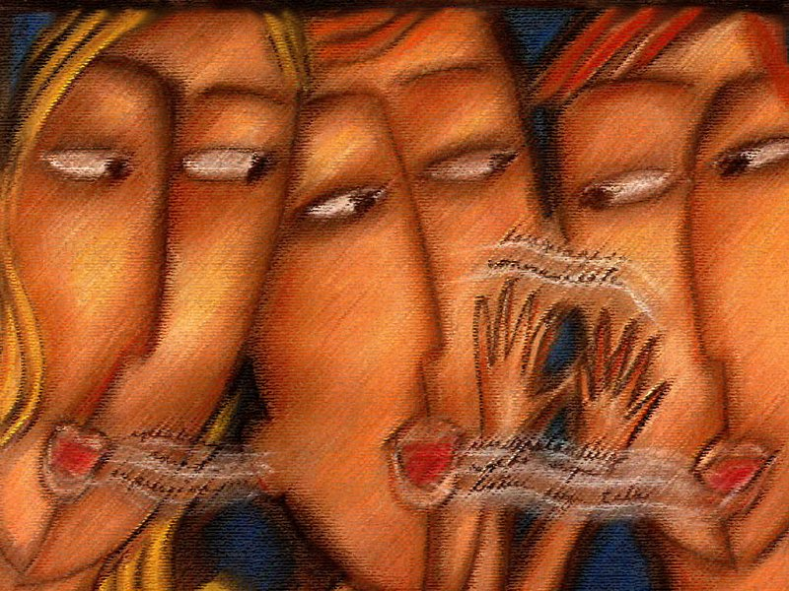
Communication
What is it?
Notes:
http://www.wallpaper.net.au/wallpaper/other/Communication%20by%20Isabelle%20Cardinal%20-%20800x600.jpg

Slide 7
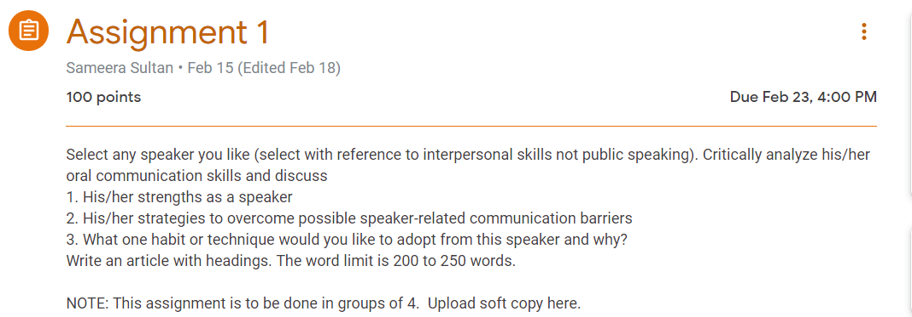
Suggest adjectives that describe communication

Slide 8
A Process is:
A set of steps leading to a desired result

Slide 9

Communication-Definition
Communication is the process of conveying information in such a way that the message is received and understood.
What is the desired result of this process?

Slide 10
The Essence of Communication
Personal process
Occurs between people
Involves change in behaviour
Means to influence others
Expression of thoughts and emotions through words & actions.
Tools for controlling and motivating people.
It is a social and emotional process.

Slide 11
Features of Communication
Two-way Process
Information Sharing and Understanding
Circular Flow
Goal Oriented
Continuous Process
Pervasive Activity.

Slide 12
The Basic Communication Process:
Message
Listener
Speaker
Feedback

Slide 13
Forms of Communication
VERBAL: Verbal form can either be spoken or written. It involves the use of words.

Slide 14
Forms of Communication
NON-VERBAL: In this form, words or graphics are not employed. It is present in written, oral, and graphic communication. It involves the use of body language, paralanguage, dressing in speech. On the other hand, format, layout, handwriting style, etc are non-verbal elements in writing.

Slide 15
Forms of Communication
GRAPHIC COMMUNICTION: It represents ideas, feelings, views, etc visually by the use of shapes, diagrams, lines, symbols, illustrations, color, etc. It can have both verbal and non-verbal elements.

Slide 16
Types of Communication
INTERPERSONAL: It involves interaction between people on a one-to-one basis or a one-to-many basis.

Slide 17
Types of Communication
INTRAPERSONAL: In this, you think about, learn about, reason with, and evaluate yourself. It includes use of one’s mental faculties for a better understanding of oneself as well as the world.

Slide 18
Types of Communication
TELEPHONIC COMMUNICATION: It uses a telephonic or any other advanced medium for communication between participants.

Slide 19
Types of Communication
PUBLIC COMMUNICATION: It involves informing and persuading the members of an audience to hold certain attitudes, values, or beliefs, so that they will think, believe, or act in a particular way; on the other hand, you can also function as a member of an audience, in which case another person will do the same for you.

Slide 20
Types of Communication
ORGANIZATIONAL COMMUNICATION: It generates from one source and takes place when the organization communicates with a number of receivers. This kind of communication can be made either to receivers within the organization, or to others outside the organization in the form of reports or meetings.

Slide 21
Types of Communication
MASS COMMUNICATION: Mass communication is communication between mass media (electronic and print) and the public.

Slide 22
Communication can be thought of as a problem solving activity in which individuals may address the following questions:
What is the situation?
What are some possible communication strategies?
What is the best course of action?
What is the best way to design the chosen message?
What is the best way to deliver the message?

